Slide 1

Contemporary Revival of Cash Waqf for Socio-economic Development through Waqf-based Personal Finance
Prof. Dr. Monzer Kahf
Amiirah B. R. Nabee Mohomed
7TH GLOBAL ISLAMIC MICROFINANCE FORUM
NOVEMBER 24 - 25, 2017 ISTANBUL - TURKEY

Slide 2
Introduction
Cash Waqf in early Islamic history
Lending cash waqf and investment cash waqf
“a perpetual or temporary holding of endowed cash to produce repeated benefits or usufructs for an objective of general or private righteousness according to the founder’s stipulated conditions”.
Historical Experiences:
  Al Tasuli Book (al Bahjah fi Sharh al Tuhfah), Cash Waqf in Maliki School: “the process of dedicating cash as waqf for the purpose of lending it to those designated as the beneficiaries without interest”.
  Al Bukhari allocated the title of one of his sub-chapters “Making a Waqf out of domestic animals, personal weapons, goods and money”.
  Imam Malik bin Anass (Circa 179H) also mentioned Cash Waqf.
  Ibn Nujaym Book (Al Bahr Al Raiq Sharh Kanz Al Daqaiq): some of the companions of Zufar used to make Waqf of Dirhams and Dinars and they used to give the cash on Mudarabah basis and give out the proceeds to charity or for the Waqf’s purpose.

Slide 3
Introduction
Historical Experiences:
  Al Bayyan wal Tahseel by Grandfather Ibn Rushd (Circa 520 AH, 1988), two incidents about Cash Waqf were reported.
  Cash Waqf practices revived in Fes in Morocco and by the Ottoman State (1301-1922 CE)
  Very dominant in Sudan and Kuwait in nineties
  Contemporary uses:
  Waqf shares to collect donations or direct deposits in bank accounts of Cash Waqf: 1999 in Oman and Kuwait, 2001 in UAE. Koc Holdings in Turkey was the first corporate body involved in establishing and administrating Waqf properties as early as 1967 and Islami Bank Bangladesh Limited (IBBL) in Bangladesh established Cash Waqf certificates in 1997 as a means of accumulating Waqf fund and channeling the proceeds to underprivileged Muslims.
  21st Century: Cash Waqf schemes are being practiced in several countries under Waqf Shares, Deposit Cash Waqf, Corporate Waqf

Slide 4
CASH NEEDS IN MICROFINANCING
Microfinance Customers
Transfer a debt to IB or convert an interest-based loan to an Islamic one;
Emergency consumption needs;
Convenience purposes and nature of transactions (where only cash payment is accepted);
Mismanagement of finance due to over-consumption and many easy credit facilities;
Change in an individual’s economic condition or status;
Rescheduling many credit facilities from different institutions into a single facility;
The customer does not want to disclose the purpose of financing.
Microfinance Businesses
Lack of securities, collaterals and guarantees;
Low cash generation or any cash shortage resulting from volatility in cash flow (risks of debt collection and debt payment);
No or small capital size ;
Risk of cash flow shortage (Selling on credit and purchasing inventory and raw materials on cash-basis or mismatch between cash receivable and cash payable);
Credit facilities not offered by banks due to high risk;
Down-payment for purchasing inventory or assets and equipment;
Payments of workers’ salaries, utility bills, daily expenses or any other cash needs;
Rescheduling credit facilities in case of default;
Nature of transactions (where only cash payment is accepted or feasible).

Slide 5
PERSONAL FINANCE IN MICROFINANCING
Cash finance is a Qard and contributory contract on which returns cannot be earned and justified.
Products more suitable in microfinance for poverty alleviation and economic empowerment - not-for-profit mechanisms: Sadaqa, Zakah, Awqaf and Qard
Resolution (140-15/6) in 2004, OIC Fiqh Academy
Cash Waqf can be in the form of interest-free loan (qard hassan), for investments whether directly or by Musharakah with many Waqifin in one fund or through issue of shares for Cash Waqf
Principal of cash lending Waqf is used for easing liquidity problems of beneficiaries whereas in cash investment Waqf, only the income is used for philanthropic, religious or private beneficiaries as assigned by the founders.
Cash Waqf Loans and Cash Waqf Microfinance Institution

Slide 6
Cash Waqf Loans
Main Conditions For Lending Cash Waqf in a Banking Context
It can be temporary or perpetual.
Conditions specified by the founder(s) are fully binding and must be followed as long as they do not violate or contradict the Shari’ah.
Purpose of the lending Cash Waqf should be defined and may be restricted to lending for specific needs only.
Beneficiaries should be defined as well as the maximum amount of loan, payment period and other terms and conditions.
The Waqf asset (cash) cannot be invested as the purpose of lending Cash Waqf is to provide cash loans and investing it may prevent some beneficiaries from benefiting from the Waqf.
Borrowers will be charged only for out-of-pocket expenses incurred in providing the loan by the lender.

Slide 7
Cash Waqf Open-Fund Instrument
Structure and Process Flow
Individual IBs if they have a separate department for microfinancing or Specialized IBs
Cash Waqf Foundation: similar to the instrument presented above with the only exception that it is fully independent and has its own legal entity.

Slide 8
Cash Waqf Open-Fund Instrument
Operational Aspects and Issues:
Fund Manager
Charge only actual costs incurred in providing the loans and collecting payments to borrowers.
Not expected to charge a management fee particularly when:
  CWF is partially funded by temporary Waqf deposits and external donors.
  Financing is restricted to the IB’s customers only.
Funding and Temporary Waqf Deposits
CSR contributions of IBs, external donors (crowdfunding) or IB’s customers or individuals and institutions who wish to make temporary Waqf as Waqf deposits (temporary and permanent)
Risk Management
Sustainability
Risk of default or non-payment, administrative expenses and inflation
To ensure capital preservation, administrative costs incurred may be borne by the IB in the case of internal CWF or charged to borrowers
Targeted Segment

Slide 9
Cash Waqf Open-Fund Instrument
Advantages
Individual cash needs for cash loans and settling interest-based loans.
Disadvantages
Non profit-based instrument and no monetary gains to IBs.
All genuine individuals cash needs that cannot otherwise be financed
Added privilege for IBs and improve public’s perception of IBs being socially-responsible corporations and add to their image
Enabling purchase of jewelry, gold, silver and foreign currencies
Contribute to socio-economic development as it is strongly linked to real market for goods and services and production channels.
Benevolent purposes
Only for individual genuine cash needs and microfinancing

Slide 10
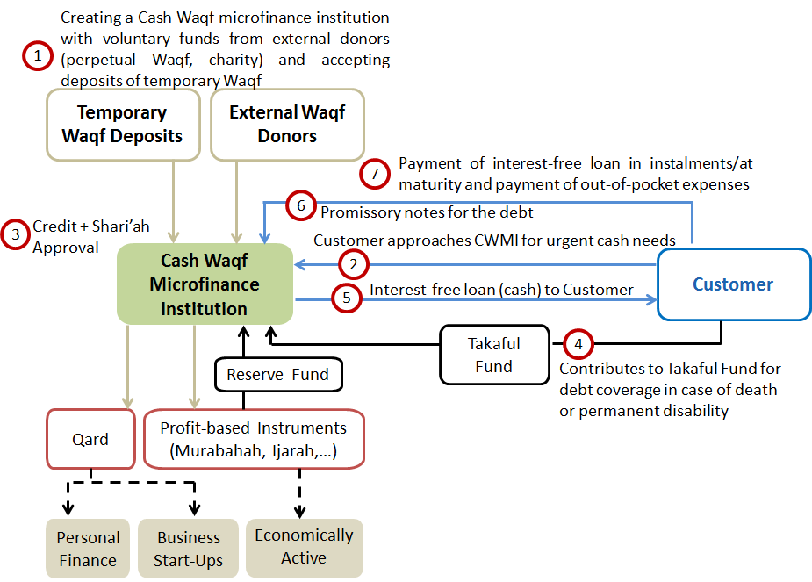
Cash Waqf Microfinance Institution
Structure and Process Flow

Slide 11
Cash Waqf Microfinance Institution
Operational Aspects
Capitalized by Waqf funds *
Categorize customers and their financing needs into different segments - use combination of profit-based modes of financing where applicable and non-profit-based mode (qard) for PF and business start-ups.
Reserve fund: covers part or all the operational expenses of the model; covers losses to ensure long-term sustainability of the institution
Internal Takaful fund to cover its customers taking qard in case of death or permanent disability.
Advantage of CWMI government operation: greater accessibility to a larger segment of the population and the government more keen to sustain the institution
* Alternately, this microfinance institution can take other legal structures namely, an Islamic financial cooperative where the major part of its capital is from Waqf funds and beneficiaries also contribute in terms of yearly member fees and savings.

Slide 12
Conclusion
Cash Waqf-based personal finance instrument can be an effective tool in fulfilling contemporary needs for individuals and in microfinancing.
It will positively affect IBs image and reputation and can also be an attractive marketing tool.
Cash Waqf-based instruments used in individual PF and microfinance PF are particularly useful in microfinancing in helping to alleviate poverty and raising the living standards of the lowest segment of society.

Slide 13
THANK YOU
Prof. Dr. Monzer Kahf
Hamad Bin Khalifa University
E-mail: monzer@kahf.com and mkahf@hbku.edu.qa
Office Phone: +974 44546567
Amiirah B. R. Nabee Mohomed
Istanbul University
Email: amiirah@ymail.com
Mob: (+90) 505 093 62 57

